Slide 1



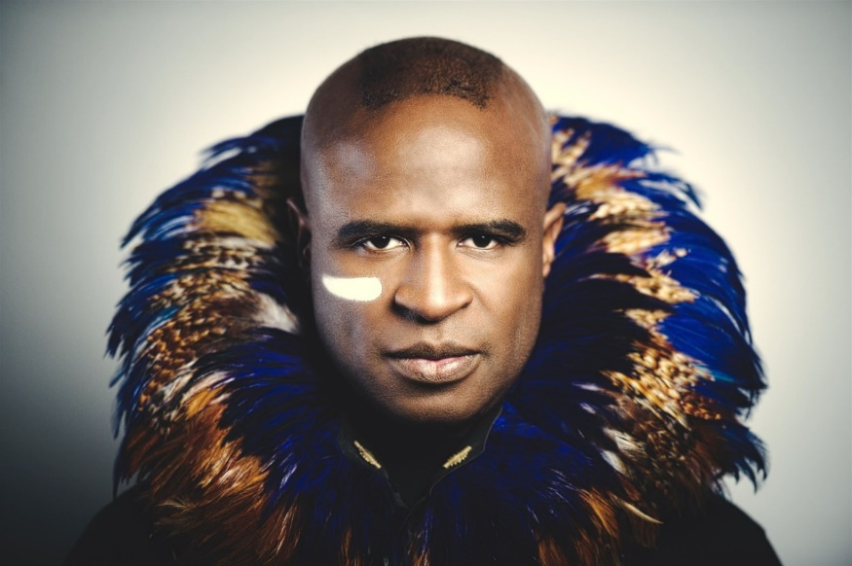
Teen Suicide: Alex Boyé Concert

Slide 2

Alex’s Story

Slide 3

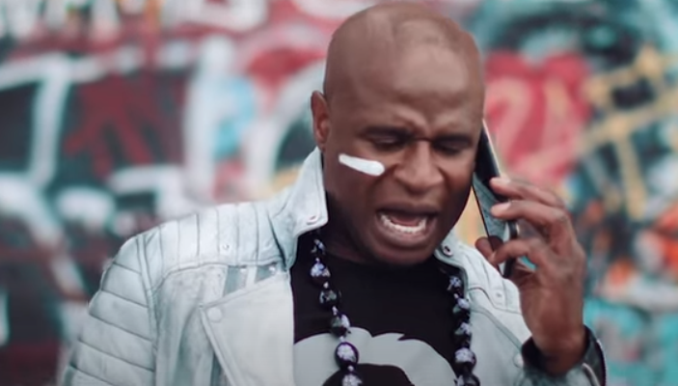
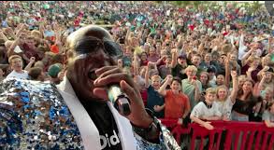
Alex’s Story
Introducing: Alex Boyé / Musician / Mental Health Ambassador
Alex Boyé’s Crusade Story
At age 16, musician and entertainer Alex Boyé found himself homeless and alone on the streets of London, eating out of trash cans. Unsatisfied with his life filled with abuse, Alex made a plan to dance away his sadness at a local nightclub and then take his life. Alex Boyé experienced the depth of darkness in his soul full of unbearable pain, that even to this day, he finds it hard to explain. But to get rid of the pain, he decided that suicide was the only escape. Moments before he carried out the act of suicide to end his excruciating pain, a song dedicated by the DJ in his honor saved his life. That song and music spoke to his soul and filled him with hope, and it changed the course of his life.

Slide 4

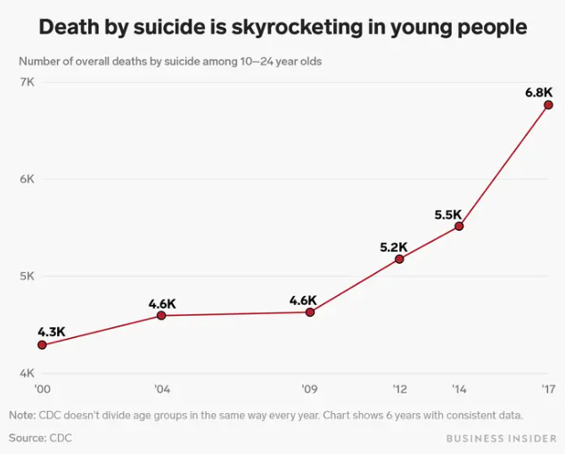
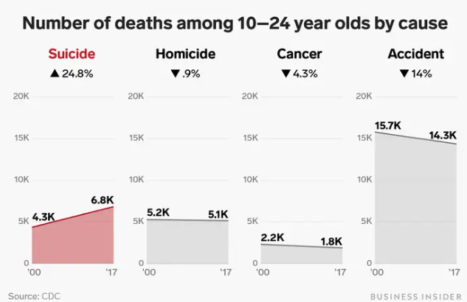
Why teen suicide prevention effort is needed
“This is not a problem to be solved. It is a battle to be won.”

Slide 5

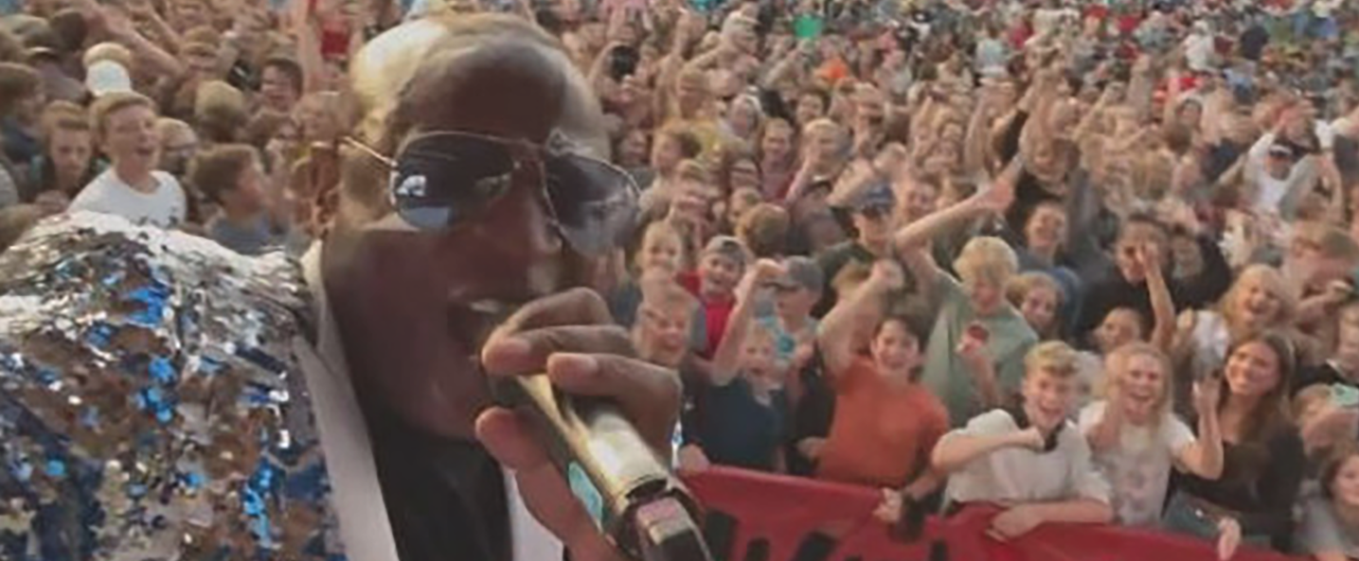

November 5, 2022 – 3:00 p.m.
FESTIVAL FIELDS AT
1 Legacy Drive, Mesa, AZ 85212

Slide 6
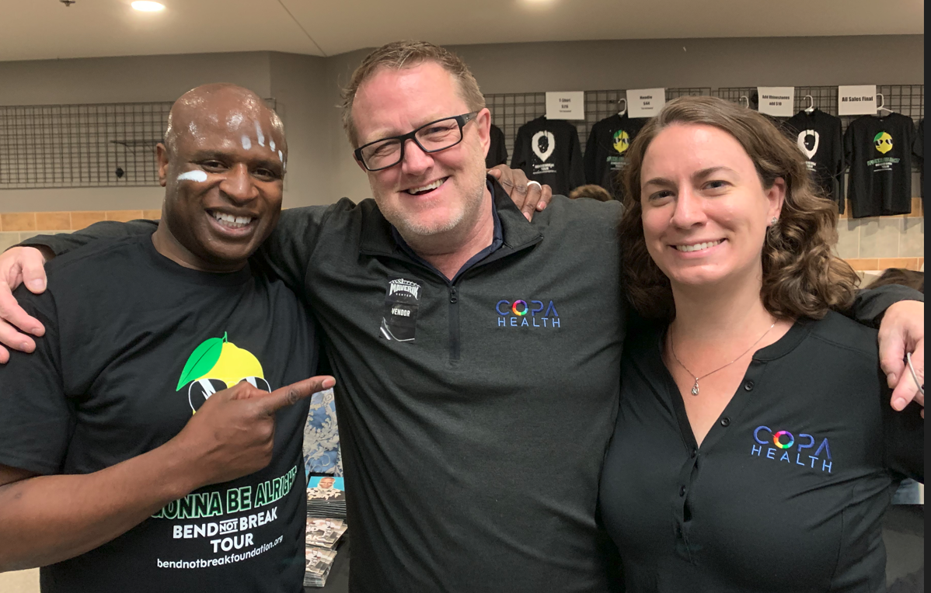
Needs
Sponsors
Volunteers for the concert
Event Committee Members
Promotion
On-going commitment

Slide 7







Concert Goals
Attendance
    15,000-20,000 Attendees
    12-21 year old demographic
Break Even Financially ($150,000.00)
Raise Awareness of Resources
Energize and Raise Ongoing Awareness Campaign

Slide 8

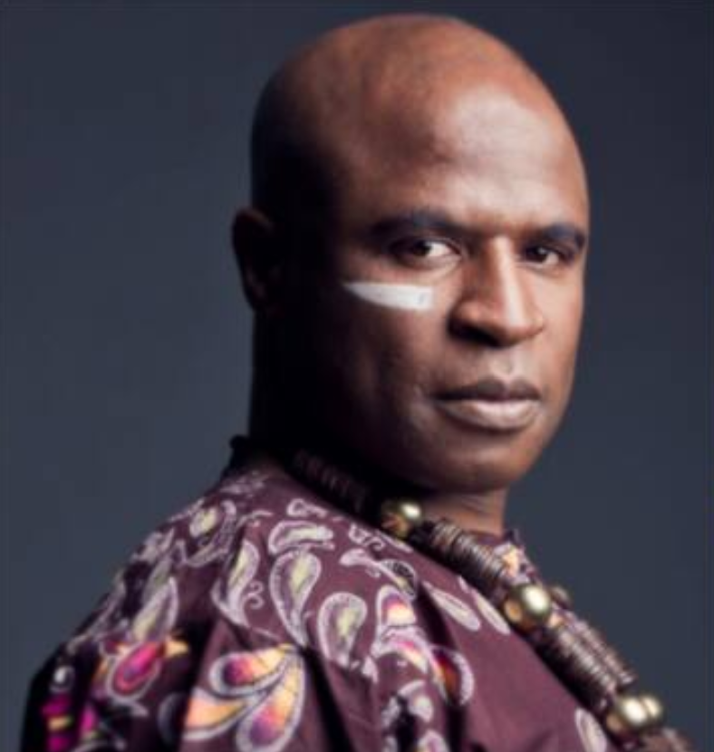
Sponsorship Levels
$50,000 – Campaign Sponsor
$25,000 - Title Sponsor (1)
$20,000 - Premier Sponsor (1)
$15,000 - Branding Sponsors (5)
$10,000 - Event Sponsors
$5,000 - Social Media Sponsors
$1,000 - Prevention Sponsors

Slide 9

$50,000 - Campaign Sponsor
- Recognition for all Suicide Prevention events and online campaign thru 2023
-Highest Profile Signage On Stage
-10 Tickets to Event/VIP Experience Tent
-Highlighted in Social Media Promotion
-Personalized Video for Promotion
-Guest Appearance on Copa Health/Chamber Video/Podcast
-Four Tickets to In-Person Private Event with Alex*
-Branding on all Concert Materials
-Booth/Table at Concert for Promotion

Slide 10
$25,000 - Title Sponsor
-High Profile Signage On Stage
-10 Tickets to Event/VIP Experience Tent
-Highlighted in Social Media Promotion
-Personalized Video for Promotion
-Guest Appearance on Copa Health/Chamber Video/Podcast
-Four Tickets to In-Person Private Event with Alex*
-Branding on all Concert Materials
-Booth/Table at Concert for Promotion

Slide 11
$20,000 - Premiere Sponsor
-High Profile Signage On Stage
-10 Tickets to Event/VIP Experience Tent
-Highlighted in Social Media Promotion
-Personalized Video for Promotion
-Two Tickets to In-Person Private Event with Alex*
-Branding on all Concert Materials
-Booth/Table at Concert for Promotion

Slide 12
$15,000 - Branding Sponsor
-Signage On Stage
-5 Tickets to Event/VIP Experience Tent
-Highlighted in Social Media Promotion
-Personalized Video for Promotion
-Two Tickets to In-Person Private Event with Alex*
-Branding on all Concert Materials
-Booth/Table at Concert for Promotion

Slide 13
$10,000 - Event Sponsor
-Signage On-Stage
-5 Tickets to Event VIP Experience Tent
-Highlighted in Social Media Promotion
-Personalized Video for Promotion
-Two Tickets to In-Person Private Event with Alex*
-Branding on all Concert Materials
-Booth/Table at Concert for Promotion

Slide 14
$5,000 – Social Media Sponsor
-Highlighted in Social Media Promotion
-Recognized as Social Media Sponsor on Social Media
-Recognized as Social Media Sponsor at the Concert
-Personalized Video for Promotion
-Two Tickets to In-Person Private Event with Alex*
-Booth/Table at Concert for Promotion
-Logo Included in Online and Published Material

Slide 15
$1,000 – Prevention Sponsor
-Recognized as Prevention Sponsor on Social Media
-Recognized as Prevention Sponsor at the Concert
-Branded Video for Promotion
-Booth/Table at Concert for Promotion
-Logo Included in Online and Published Material
Notes:
1 of 8 slides Joy Ann

Slide 16
Questions?
Contact Jeff Bayer – jeff.bayer@copahealth.org - 650.533.4949
Mesa, AZ – November 5, 2022
Festival Fields At
1 Legacy Drive Mesa, AZ 85212

